Slide 1
RANDOM FOREST
TEAM : Sunday

Slide 2
WHAT IS RANDOM FOREST?
An ensemble classifier using many decision tree models.
Can be used for classification or Regression.
Accuracy and variable importance information is provided with the results.

Slide 3
ALGORITHM
Let the number of training cases be N, and the number of variables in the classifier be M.
The number m of input variables are used to determine the decision at a node of the tree; m should be much less than M.
Choose a training set for this tree by choosing N times with replacement from all N available training cases. Use the rest of the cases to estimate the error of the tree, by predicting their classes.
For each node of the tree, randomly choose m variables on which to base the decision at that node. Calculate the best split based on these m variables in the training set.
Each tree is fully grown and not pruned.

Slide 4
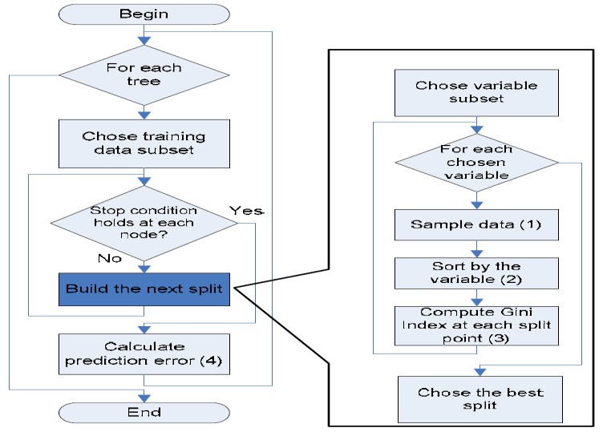
FLOW CHART

Slide 5
ADVANTAGES
It produces a highly accurate classifier and learning is fast
It runs efficiently on large data bases.
It can handle thousands of input variables without variable deletion.
It computes proximities between pairs of cases that can be used in clustering, locating outliers or (by scaling) give interesting views of the data.
It offers an experimental method for detecting
variable interactions.

Slide 6

GINI INDEX
Random Forest uses the Gini index taken from the CART learning system to construct decision trees. The Gini index of node impurity is the measure most commonly chosen for classification-type problems. If a dataset T contains examples from n classes,
Gini index, Gini(T) is defined as:

Slide 7

DEFINITION OF (T)
T can be defined as:

Slide 8
OPERATION
A random seed is chosen which pulls out at random a collection of samples from the training dataset while maintaining the class distribution.
With this selected data set, a random set of attributes from the original data set is chosen based on user defined values. All the input variables are not considered because of enormous computation and high chances of over fitting.

Slide 9
In a dataset where M is the total number of input attributes in the dataset, only R attributes are chosen at random for each tree where R< M.
The attributes from this set creates the best possible split using the Gini index to develop a decision tree model. The process repeats for each of the branches until the termination condition stating that leaves are the nodes that are too small to split.

Slide 10
EXAMPLE
The example below shows the construction of a single tree using the abridged dataset.
RECORD | ATTRIBUTES |  | CLASS
 | HOME_TYPE | SALARY
1 | 31 | 3 | 1
2 | 30 | 1 | 0
3 | 6 | 2 | 0
4 | 15 | 4 | 1
5 | 10 | 4 | 0

Slide 11
HOME_TYPE AT THE VALUE 6
Attribute | Number of records
 | Zero(0) | One (1) | N = 5
HOME_TYPE <=6 | 1 | 0 | n1 = 1
HOME_TYPE > 6 | 2 | 2 | n2 = 4

Slide 12
HOME_TYPE AT THE VALUE 10
Attribute | Number of records
 | Zero(0) | One (1) | N = 5
HOME_TYPE <=6 | 1 | 0 | n1 = 1
HOME_TYPE > 6 | 2 | 2 | n2 = 4

Slide 13
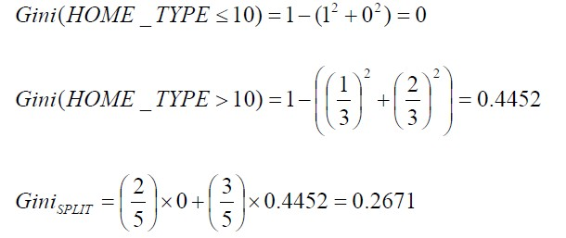
GINI SPLIT AT THE VALUE 10

Slide 14
GINI SPLIT VALUES AT EVERY HOME_TYPE
Gini SPILT | Value
Gini SPILT(HOME_TYPE<=6) | 0.4000
Gini SPILT(HOME_TYPE<=10) | 0.2671
Gini SPILT(HOME_TYPE<=15) | 0.4671
Gini SPILT(HOME_TYPE<=30) | 0.3000
Gini SPILT(HOME_TYPE<=31) | 0.4800
**The split HOME_TYPE<=10 has the lowest value

Slide 15
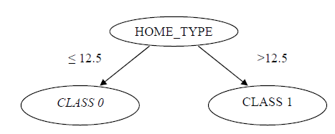
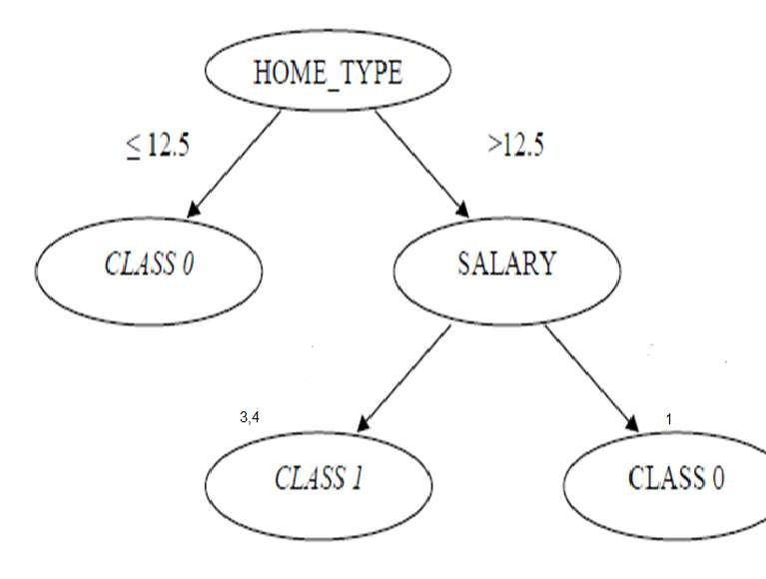
SPLITTING ACROSS CLASS

Slide 16
RANDOM FOREST IMPLEMENTATION USING R STUDIO

Slide 17
THANK YOU
HINGOLI PRITHVI

